Slide 1
Chapter 4: Peripheral programming in C
Stellaris® Cortex-M3 - Microcontroller Family
Texas Instruments
Texas Instruments - University Program
Heilbronn University, Campus Künzelsau
Prof. Dr.-Ing. Ralf Gessler Rev. 1.0

Slide 2
Content
Chapter 4: Peripheral Programming in C 4.1 General Purpose IO (GPIO) 4.2 Interrupt functions 4.3 Timers: General purpose and PWM 4.4 Analogue: ADC 4.5 Serial interfaces: UART
Topics: timer, PWM, interrupts, GPIO, NVIC, EKS-LM3S1968, LED, OLED, StellarisWare®, API, C language

Slide 3
Learning Objectives
This chapter gives practical experience of the Stellaris® timers and timer-interrupts.
The StellarisWare® API is applied to control the timer interrupts
Application “Blinky with timer” triggers the on-board LED
Structure and questions:
What does the General-Purpose Timer Module look like?
What are the features of the General-Purpose Timer?
How can I apply StellarisWare® to running the general purpose timers?

Slide 4
General view
Timer
Principle
A simple counter
Runs to pre-defined value (e.g. to a maximum)
Triggers an interrupt
Interrupt frequency depends on the pre-defined counter value or the register clocking
Application (example)
Time base
Pulse-Width-Modulation (PWM)
Principle
Based on a timer
Control the electrical energy by modulating the pulse-width
Application (example)
Motor control

Slide 5
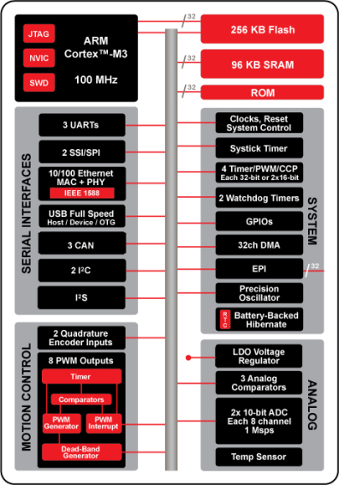

Overview: Stellaris®
80 MHz
Explanations
based on
Stellaris®
LM3S1968

Slide 6
Main Features
Four General-Purpose Timer Modules (GPTM)
Referred to as Timer0, Timer1, Timer 2, and Timer 3
each GPTM provides two 16-bit timers/counters
Referred to as TimerA and TimerB.
each GPTM can be configured to operate independently:
As a single 32-bit timer
As one 32-bit Real-Time Clock (RTC) to event capture
For Pulse Width Modulation (PWM)
To trigger analog-to-digital conversions
32-bit Timer modes
Programmable one-shot timer
Programmable periodic timer
Real-Time Clock when using an external 32.768-KHz clock as the input
User-enabled stalling when the controller asserts CPU Halt flag during debug
ADC event trigger

Slide 7
Main Features
16-bit Timer modes
General-purpose timer function with an 8-bit pre-scaler (for one-shot and periodic modes only)
Programmable one-shot timer
Programmable periodic timer
User-enabled stalling when the controller asserts CPU Halt flag during debug
ADC event trigger
16-bit Input Capture modes
Input edge count capture
Input edge time capture
16-bit PWM mode
Simple PWM mode with software-programmable output inversion of the PWM signal

Slide 8
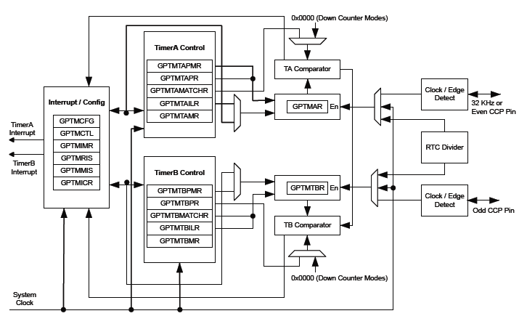
GPTM Module Block Diagram
GPTM

Slide 9
Functional Description I
Overview
Access of the features takes place through the StellarisWare® API
The timer Application Programming Interface (API) provides a set of functions for dealing with the timer module
Functions are provided to configure and control the timer, along with functions to modify timer/counter values, and to manage interrupt handling for the timer.
The StellarisWare® driver is contained in driverlib/timer.c, with driverlib/timer.h containing the API definitions for use by applications
Link: see Chapter 3.4 “Stellarisware®” for further information.

Slide 10
Functional Description II
Timer operating modes
The timer module provides two 16-bit timer/counters that can be configured to operate independently as timers or event counters, or they can be configured to operate as one 32-bit timer or one 32-bit Real Time Clock (RTC)
When configured as either a 32-bit or 16-bit timer, a timer can be set up to run as a one-shot timer or a continuous timer
If configured as a one-shot timer, when it reaches zero the timer will cease counting
If configured as a continuous timer, when it reaches zero the timer will continue counting from a reloaded value

Slide 11
Functional Description III
Additional operating modes
When configured as a 32-bit timer, the timer can also be configured to operate as an RTC.
In that case, the timer expects to be driven by a 32.768 KHz external clock, which is divided down to produce 1 second clock ticks
When in 16-bit mode, the timer can also be configured for event capture or as a Pulse Width Modulation (PWM) generator
When configured for event capture, the timer acts as a counter. It can be configured to either count the time between events, or it can count the events themselves
When a timer is configured as a PWM generator, the input line used to capture events becomes an output line, and the timer is used to drive an edge-aligned pulse onto that line

Slide 12
Functional Description IV
Interrupts and Events
Control is also provided over interrupt sources and events
Interrupts can be generated to indicate that an event has been captured, or that a certain number of events have been captured
Interrupts can also be generated when the timer has counted down to zero, or when the RTC matches a certain value

Slide 13
Timer driver lib
The timer API consists of three function groups:
Configuration and control
Contents
Interrupt-handling
Timer configuration
Is handled by the function TimerConfigure()
It is used to set up 32- or 16-bit modes, and
To select between PWM, capture, and timer operations
Timer control
Timer status is configured by a set of control functions:
TimerEnable(), TimerDisable(), TimerControlLevel(), TimerControlTrigger(), TimerControlEvent(), TimerControlStall(), TimerRTCEnable(), and TimerRTCDisable()

Slide 14
Timer driver lib II
Timer contents
values and scaling of timers can be configured by the following set of functions:
TimerLoadSet(), TimerLoadGet(), TimerPrescaleSet(), TimerPrescaleGet(), TimerMatchSet(), TimerMatchGet(), TimerPrescaleMatchSet(), TimerPrescaleMatchGet(), and TimerValueGet()
Timer Interrupts
The interrupt handler for the Timer interrupt is managed by: TimerIntRegister() and TimerIntUnregister()
The individual interrupt sources within the timer module are managed by:
TimerIntEnable(), TimerIntDisable(), TimerIntStatus(), and TimerIntClear()

Slide 15
Example “Timers_blinky”
Description
This example application demonstrates the use of the timers to generate periodic interrupts.
One timer is set up to interrupt once per second and the other to interrupt twice per second.
Each interrupt handler will toggle its own indicator on the display.
Additionally the on-board LED is toggled by Timer0 ISR.
Learning elements
Microcontroller
GPIO (LED), Timer
Evaluation Board
On-board LED, On-board display
Functional test (debugging)
Blinking on-Board LED
Interrupt status on display
Link: see Lab “lab43a.zip”

Slide 16
Example “Timers_blinky” Part I
#include "inc/hw_ints.h"
#include "inc/hw_memmap.h"
#include "inc/hw_types.h"
#include "driverlib/debug.h"
#include "driverlib/gpio.h"
#include "driverlib/interrupt.h"
#include "driverlib/sysctl.h"
#include "driverlib/timer.h"
#include "drivers/rit128x96x4.h"
#include "inc/lm3s1968.h" // HHN
unsigned long g_ulFlags;
//
// HHN
//
int g_LEDON;
...
Header files: GPIO, timers, display
Extension: HHN MEE-Project-Lab, SS11
Indicates status of LED

Slide 17
Example “Timers_blinky” Part II
...
#ifdef DEBUG
void
__error__(char *pcFilename, unsigned long ulLine)
{
}
#endif
void
Timer0IntHandler(void)
{
//
// Clear the timer interrupt.
//
TimerIntClear(TIMER0_BASE, TIMER_TIMA_TIMEOUT);
//
// Toggle the flag for the first timer.
//
HWREGBITW(&g_ulFlags, 0) ^= 1;
...
Timer0 Interrupt Service Routine

Slide 18
Example “Timers_blinky” Part III
...
//*****************************************************************************
//
// HHN
//
//*****************************************************************************
if (g_LEDON == 0)
{
//
// Turn on the LED.
//
GPIO_PORTG_DATA_R |= 0x04;
g_LEDON = 1;
}
else
{
//
// Turn off the LED.
//
GPIO_PORTG_DATA_R &= ~(0x04);
g_LEDON = 0;
}
//*****************************************************************************
...
Toggle LED on/off
Update g_LEDON variable

Slide 19
Example “Timers_blinky” Part IV
...
//
// Update the interrupt status on the display.
//
IntMasterDisable();
RIT128x96x4StringDraw(HWREGBITW(&g_ulFlags, 0) ? "1" : "0", 48, 32, 15);
IntMasterEnable();
}
void
Timer1IntHandler(void)
{
//
// Clear the timer interrupt.
//
TimerIntClear(TIMER1_BASE, TIMER_TIMA_TIMEOUT);
//
// Toggle the flag for the second timer.
//
HWREGBITW(&g_ulFlags, 1) ^= 1;
...
Print information on the display
Timer1 Interrupt Service Routine

Slide 20
Example “Timers_blinky” Part V
...
//
// Update the interrupt status on the display.
//
IntMasterDisable();
RIT128x96x4StringDraw(HWREGBITW(&g_ulFlags, 1) ? "1" : "0", 90, 32, 15);
IntMasterEnable();
}
int
main(void)
{
volatile unsigned long ulLoop; // HHN
//
// Set the clocking to run directly from the crystal.
//
SysCtlClockSet(SYSCTL_SYSDIV_1 | SYSCTL_USE_OSC | SYSCTL_OSC_MAIN |
SYSCTL_XTAL_8MHZ);
...
Print information on the Display
Main Routine

Slide 21
Example “Timers_blinky” Part VI
...
//*****************************************************************************
//
//HHN
//
//*****************************************************************************
//
// Enable the GPIO port that is used for the on-board LED.
//
SYSCTL_RCGC2_R = SYSCTL_RCGC2_GPIOG;
//
// Do a dummy read to insert a few cycles after enabling the peripheral.
//
ulLoop = SYSCTL_RCGC2_R;
g_LEDON = 0; // PROLAB
//
// Enable the GPIO pin for the LED (PG2). Set the direction as output, and
// enable the GPIO pin for digital function.
//
GPIO_PORTG_DIR_R = 0x04;
GPIO_PORTG_DEN_R = 0x04;
...
Configure onboard LED

Slide 22
Example “Timers_blinky” Part VII
...
//
// Initialize the OLED display and write status.
//
RIT128x96x4Init(1000000);
RIT128x96x4StringDraw("Timers example", 18, 24, 15);
RIT128x96x4StringDraw("T1: 0 T2: 0", 24, 32, 15);
//
// Enable the peripherals used by this example.
//
SysCtlPeripheralEnable(SYSCTL_PERIPH_TIMER0);
SysCtlPeripheralEnable(SYSCTL_PERIPH_TIMER1);
//
// Enable processor interrupts.
//
IntMasterEnable();
...
Configure OLED display
Enable interrupts

Slide 23
Example “Timers_blinky” Part VIII
...
//
// Configure the two 32-bit periodic timers.
//
TimerConfigure(TIMER0_BASE, TIMER_CFG_32_BIT_PER);
TimerConfigure(TIMER1_BASE, TIMER_CFG_32_BIT_PER);
TimerLoadSet(TIMER0_BASE, TIMER_A, SysCtlClockGet());
TimerLoadSet(TIMER1_BASE, TIMER_A, SysCtlClockGet() / 2);
//
// Setup the interrupts for the timer timeouts.
//
IntEnable(INT_TIMER0A);
IntEnable(INT_TIMER1A);
TimerIntEnable(TIMER0_BASE, TIMER_TIMA_TIMEOUT);
TimerIntEnable(TIMER1_BASE, TIMER_TIMA_TIMEOUT);
//
// Enable the timers.
//
TimerEnable(TIMER0_BASE, TIMER_A);
TimerEnable(TIMER1_BASE, TIMER_A);
...
Configure timers
Enable timer interrupts
Enable timers

Slide 24
Example “Timers_blinky” Part IX
...
//
// Loop forever while the timers run.
//
while(1)
{
}
}
Loop forever

Slide 25
Questions and Exercises
Design a structured flowchart for “Timers_Blinky”.
Which programming model applies to “Timers_Blinky”?
What is PWM? Give an application example?
Exercise
Modify the LED blink frequency.
Implement a digital watch.

Slide 26
Summary and Outlook
Summary
From General-Purpose Timer Module to StellarisWare® API
From “Blinky with loop” to “Blinky with timer”
Outlook/How to go on?
The General-Purpose Timer Modules are basic functionality applied in the next labs

Slide 27
References
[1] Texas Instruments: Data Sheet - Stellaris® LM3S1968. Chapter 9; spms037f.pdf, 2011.
[2] Texas Instruments: User’s Guide - Stellaris® LM3S1968 Evaluation Board. spmu037a.pdf, 2010.
[3] Texas Instruments: StellarisWare®. Path: \boards\ek-lm3s1968\ timers, 2011.
[4] Brenner, S.; Mitsch, F.: Project Teaching ROM. Lab “Blinky with timer interrupts”; MEE-Project-Lab; HS Heilbronn, Campus KÜN, 20.06.2011.

